Slide 1
Stock Market Prediction
Project by: Vidushi & Anju Luthra

Slide 2
AGENDA
Problem statement
Project overview
The end-users
Wow factor
Results
Meet our team

Slide 3
PROBLEM STATEMENT
Accessible Information:
Bridge the information gap by providing easily accessible and understandable stock market insights.
Eliminate dependence on costly brokerage consultations for basic investment knowledge.
Data-Driven Decision Support:
Utilize data analysis to distill complex stock market trends into comprehensible insights.
Empower users with a tool that aids in making informed investment decisions.
Risk Mitigation:
Reduce the risk of misinformation and scams by offering a trustworthy, data-backed alternative.
Educate users on common pitfalls and best practices in stock market investments.

Slide 4
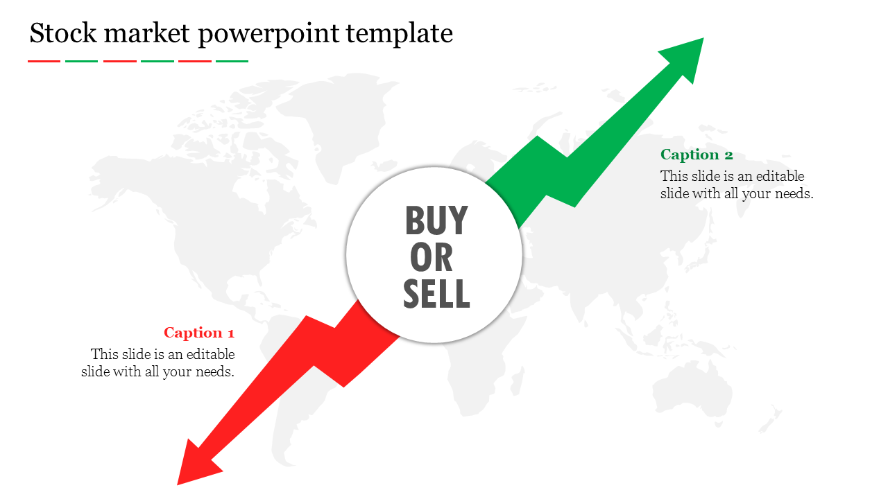
PROJECT OVERVIEW
The project aims to empower individuals with the ability to make informed stock market investments by providing real-time stock price predictions and valuable financial insights. By leveraging data analysis, machine learning, and user-friendly interfaces, the project seeks to democratize access to stock market knowledge, reduce dependency on costly consultations, and mitigate the risk of misinformation and scams.

Slide 5
WHO ARE THE END USERS?
The target end users for this project are individuals who are interested in entering the stock market and making informed investment decisions. This includes:
Novice Investors:
Individuals with limited or no experience in stock market investments.
Independent Investors:
Users who prefer to manage their investments independently without relying heavily on broker consultations.
Financial Enthusiasts:
Individuals passionate about understanding the intricacies of the stock market
Cost-Conscious Investors:
Individuals looking to avoid unnecessary consultancy fees and scams associated with misinformation.

Slide 6


THE WOW IN OUR SOLUTION
Wow Factor: Real-Time Stock Market Empowerment at Your Fingertips!
Instant Insights, Future Decisions:
Experience the power of accurate, real-time stock predictions for making decisions at the speed of the market.
Sleek Simplicity, Powerful Understanding:
A visually appealing and user-friendly interface that turns intricate financial data into actionable insights.
Educate to Elevate:
Unlock a wealth of educational resources that transforms every user into a knowledgeable and confident investor.
Transparency Unleashed:
Gain unprecedented clarity with data-driven insights, providing a shield against misinformation and scams.
Cost-Efficiency, No Strings Attached:
Bid farewell to consultancy fees with a cost-effective alternative, ensuring the benefits of informed decisions without breaking the bank.

Slide 7
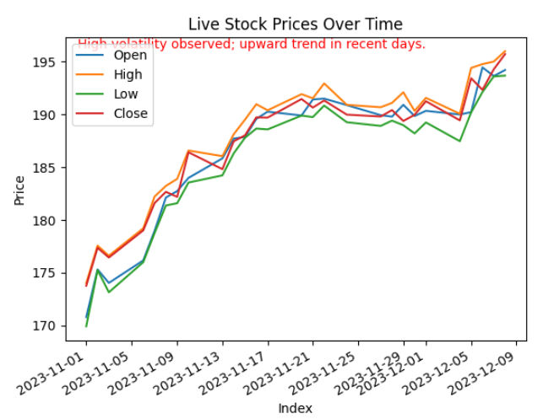
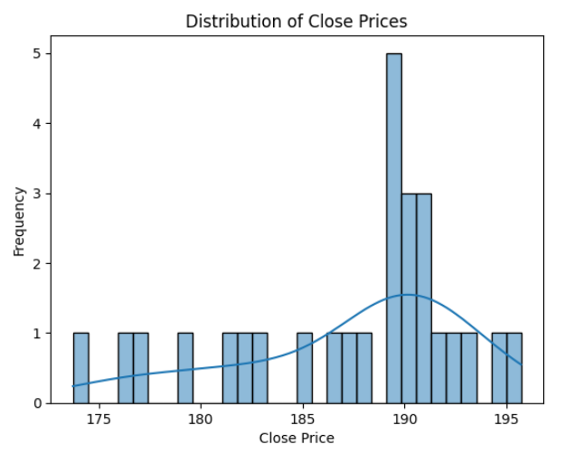
RESULTS
The project aims to give you accurate predictions about stocks right when you need them. We're making it super easy to understand, even if you're new to this. You'll have cool graphs and stuff to look at. Plus, we're sharing lots of info to help you understand how it all works. And guess what? You won't have to pay a ton for advice because we're keeping it affordable. So, you can make smart decisions all by yourself and feel awesome about it!

Slide 8


MEET OUR TEAM
Anju luthra
Vidushi garg

Slide 9
THANK YOU

